Slide 1
Graphical User Interfaces
Java’s AWT and Swing APIs

Slide 2
AWT and Swing
Java provides two sets of components for GUI programming:
  AWT: classes in the java.awt package
  Swing: classes in the javax.swing package

Slide 3
Abstract Window Toolkit (AWT)
The Abstract Window Toolkit is a portable GUI library.
AWT provides the connection between your application and the native GUI.
AWT provides a high-level abstraction since it hides you from the underlying details of the GUI your program will be running on.
AWT components depend on native code counterparts (called peers) to handle their functionality. Thus, these components are often called heavyweight components.

Slide 4
Swing
Swing implements GUI components that build on AWT technology.
Swing is implemented entirely in Java.
Swing components do not depend on peers to handle their functionality. Thus, these components are often called lightweight components.

Slide 5
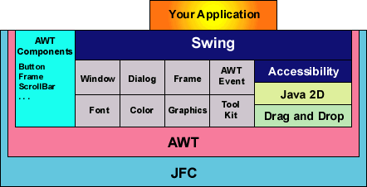
Swing Stack
Notes:
JFC: Java Foundation Classes; includes Swing and AWT
Notice that some AWT components are not used by Swing but others are. Not used by Swing: Button, Frame, etc. Used by Swing: Window, Dialog, Event, Color, etc.

Slide 6
Some AWT and Swing Classes
java.lang.Object
java.awt.Component
java.awt.Container
javax.swing.JComponent
java.awt.Window
javax.swing.JPanel
java.awt.Frame
javax.swing.JFileChooser
javax.swing.JPopupMenu
javax.swing.JFrame
javax.swing.JToolbar
javax.swing.JLabel

Slide 7
AWT: Pros and Cons
Pros
  Speed: native components speed performance.
  Look and feel: AWT components more closely reflect the look and feel of the OS they run on.
Cons
  Portability: use of native peers creates platform specific limitations.
  Features: AWT supports only the lowest common denominator—e.g. no tool tips or icons.

Slide 8
Swing: Pros and Cons
Pros
  Portability: Pure Java implementation.
  Features: Not limited by native components.
  Look and Feel: Pluggable look and feel. Components automatically have the look and feel of the OS their running on.
Cons
  Performance: Swing components handle their own painting (instead of using APIs like DirectX on Windows).
  Look and Feel: May look slightly different than native components.

Slide 9
Summary of AWT vs. Swing
Use Swing!

Slide 10
Main Steps in GUI Programming
To make any graphic program work we must be able to create windows and add content to them.
To make this happen we must:
  Import the awt or swing packages.
  Set up a top-level container.
  Fill the container with GUI components.
  Install listeners for GUI Components.
  Display the container.

Slide 11

Hello World Example
import javax.swing.*;
public class HelloWorldSwing {
public static void main(String[] args) {
JFrame frame = new JFrame("HelloWorldSwing");
final JLabel label = new JLabel("Hello World");
frame.add(label);
frame.setDefaultCloseOperation(
JFrame.EXIT_ON_CLOSE);
frame.pack();
frame.setVisible(true);
}
}
Notes:
Must import javax.swing.*
First, create frame (window) with the title bar contents equal to “HelloWorldSwing”.
Create a label with the text “Hello World”.
Add the label to the frame.
Set the behavior that occurs when the window is closed. In this case, we exit the program.
Pack the contents of the frame.
Show the window on screen.

Slide 12
Event handling in Java
The GUI programming is inherently event-driven; whenever a user initiates an activity such as a mouse activity, clicks, scrolling, etc., each is known as an event that is mapped to a code to respond to functionality to the user. This is known as event handling.

Slide 13
Event handling (EH) in Java
Event Handling is the mechanism that controls the event and decides what should happen if an event occurs.
This mechanism have the code which is known as event handler that is executed when an event occurs.
Java Uses the Delegation Event Model to handle the events.
This model defines the standard mechanism to generate and handle the event.

Slide 14
EH in Java: Delegation Event Model
The modern approach to handling events is predicated on the delegation event model, which defines standard and consistent mechanisms to get and process events.
Its concept is sort of simple: a source generates an occasion and sends it to at least one or more listeners.
In this scheme, the listener simply waits until it receives an occasion. Once an occasion is received, the listener processes the event then returns.

Slide 15
EH in Java: Delegation Event Model
The Delegation Event model is defined to handle events in GUI programming languages. The GUI stands for Graphical User Interface, where a user graphically/visually interacts with the system.
Using the delegation event model is actually quite easy. Just follow these two steps:
  Implement the appropriate interface in the listener so that it will receive the type of event desired.
  Implement code to register and unregister (if necessary) the listener as a recipient for the event notifications.

Slide 16
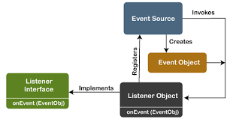
EH in Java: Delegation Event Model
Notes:
https://www.javatpoint.com/delegation-event-model-in-java

Slide 17
EH in Java: Delegation Event Model
Advantage of using Delegation Event Model
The advantage of this design is that the appliance logic that processes events is cleanly separated from the interface logic that generates those events.
An interface element is in a position to “delegate” the processing of an occasion to a separate piece of code.
In the delegation event model, listeners must register with a source so as to receive an occasional notification.
This provides is a crucial benefit: notifications are sent only to listeners that want to receive them. This is a more efficient way to handle events..
Note: Java also allows you to process events without using the delegation event model. This can be done by extending an AWT component.

Slide 18
Handling Events
Every time the user types a character or pushes a mouse button, an event occurs.
Any object can be notified of the event.
All the object has to do is implement the appropriate interface and be registered as an event listener on the appropriate event source.

Slide 19
How to Implement an Event Handler
Every event handler requires three pieces of code:
  declaration of the event handler class that implements a listener interface or extends a class that implements a listener interface
    public class MyClass implements ActionListener {
  registration of an instance of the event handler class as a listener
  someComponent.addActionListener(instanceOfMyClass);
  3. providing code that implements the methods in the listener interface in the event handler class
  public void actionPerformed(ActionEvent e) { ...//code that reacts to the action...
  }

Slide 20

A Simpler Event Example
1
public class ButtonClickExample extends JFrame implements ActionListener {
JButton b = new JButton("Click me!");
public ButtonClickExample() {
b.addActionListener(this);
getContentPane().add(b);
pack();
setVisible(true);
}
public void actionPerformed(ActionEvent e) {
b.setBackground(Color.CYAN);
}
public static void main(String[] args) {
new ButtonClickExample();
}
}
2
3

Slide 21
Example Summary
(1) declares a class that implements a listener interface (i.e. ActionListener)
(2) registers an instance of this class with the event source
(3) defines the action to take when the event occurs

Slide 22
ImageIcon
Some Swing components can be decorated with an icon—a fixed-size image.
A Swing icon is an object that adheres to the Icon interface.
Swing provides a particularly useful implementation of the Icon interface: ImageIcon.
ImageIcon paints an icon from a GIF or a JPEG image.

Slide 23
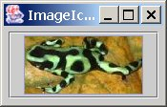
ImageIcon Example
import javax.swing.*;
public class ImageIconExample extends JFrame {
public static void main(String[] args) {
JFrame frame = new JFrame("ImageIcon Example");
ImageIcon icon = new ImageIcon("smallfrog.jpg");
JPanel panel = new JPanel();
JButton button = new JButton(icon);
panel.add(button);
frame.getContentPane().add(panel);
frame.pack();
frame.setVisible(true);
}
}

Slide 24
JTextField Example (1)
public class CelsiusConverter implements ActionListener {
JFrame converterFrame;
JPanel converterPanel;
JTextField tempCelsius;
JLabel celsiusLabel, fahrenheitLabel;
JButton convertTemp;
public CelsiusConverter() {
converterFrame = new JFrame("Convert Celsius to
Fahrenheit");
converterPanel = new JPanel();
converterPanel.setLayout(new GridLayout(2, 2));
addWidgets();
converterFrame.getContentPane().add(converterPanel,
BorderLayout.CENTER);
converterFrame.setDefaultCloseOperation(
JFrame.EXIT_ON_CLOSE);
converterFrame.pack();
converterFrame.setVisible(true);
}

Slide 25
JTextField Example (2)
private void addWidgets() {
tempCelsius = new JTextField(2);
celsiusLabel = new JLabel("Celsius",
SwingConstants.LEFT);
convertTemp = new JButton("Convert...");
fahrenheitLabel = new JLabel("Fahrenheit",
SwingConstants.LEFT);
convertTemp.addActionListener(this);
converterPanel.add(tempCelsius);
converterPanel.add(celsiusLabel);
converterPanel.add(convertTemp);
converterPanel.add(fahrenheitLabel);
}

Slide 26

JTextField Example (3)
public void actionPerformed(ActionEvent event) {
int tempFahr = (int)((Double.parseDouble(
tempCelsius.getText())) * 1.8 + 32);
fahrenheitLabel.setText(tempFahr + " Fahrenheit");
}
public static void main(String[] args) {
CelsiusConverter converter = new CelsiusConverter();
}
} // end CelciusConverter class

Slide 27
JCheckBox Example (1)
public class CheckBoxDemo extends JPanel implements ActionListener {
JCheckBox chinButton;
JCheckBox glassesButton;
JCheckBox hairButton;
JCheckBox teethButton;
JButton goButton = new JButton("Go!");
public CheckBoxDemo() {
chinButton = new JCheckBox("Chin");
chinButton.setSelected(true);
glassesButton = new JCheckBox("Glasses");
glassesButton.setSelected(true);
hairButton = new JCheckBox("Hair");
hairButton.setSelected(true);
teethButton = new JCheckBox("Teeth");
teethButton.setSelected(true);
goButton.addActionListener(this);
setLayout(new GridLayout(0, 1));
add(chinButton);
add(glassesButton);
add(hairButton);
add(teethButton);
add(goButton); }
Notes:
Note it’s a JPanel subclass. This means it cannot exist alone. We must put it in a JFrame at some point.

Slide 28
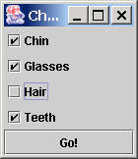
JCheckBox Example (2)
public static void main(String s[]) {
JFrame frame = new JFrame("CheckBoxDemo");
frame.setDefaultCloseOperation(
JFrame.EXIT_ON_CLOSE );
frame.getContentPane().add(new CheckBoxDemo());
frame.pack();
frame.setVisible(true);
}
public void actionPerformed(ActionEvent e) {
if (glassesButton.isSelected()) {
System.out.println("Glasses = true");
}
else {
System.out.println("Glasses = false");
}
System.exit(0);
}
}
Notes:
After the user is satisfied with the choices, check which ones he ended up with.

Slide 29
Example Summary
You may not want to be alerted every time the user selects or deselects a checkbox.
A more common use is to check the state of the button when the user clicks a button signifying that he/she is done and ready to advance.

Slide 30
JRadioButton Example (1)
public class RadioButtonDemo extends JPanel implements ActionListener {
String birdString = "Bird";
String catString = "Cat";
String dogString = "Dog";
String rabbitString = "Rabbit";
String pigString = "Pig";
JRadioButton birdButton = new JRadioButton(birdString);
JRadioButton catButton = new JRadioButton(catString);
JRadioButton dogButton = new JRadioButton(dogString);
JRadioButton rabbitButton = new JRadioButton(rabbitString);
JRadioButton pigButton = new JRadioButton(pigString);
JButton goButton = new JButton("Go!");
public RadioButtonDemo() {
birdButton.setSelected(true);
ButtonGroup group = new ButtonGroup();
group.add(birdButton);
group.add(catButton);
group.add(dogButton);
group.add(rabbitButton);
group.add(pigButton);
...

Slide 31
JRadioButton Example (2)
goButton.addActionListener(this);
setLayout(new GridLayout(0, 1));
add(birdButton);
add(catButton);
add(dogButton);
add(rabbitButton);
add(pigButton);
add(goButton);
}
public static void main(String s[]) {
JFrame frame = new JFrame("RadioButtonDemo");
frame.setDefaultCloseOperation(
JFrame.EXIT_ON_CLOSE);
frame.getContentPane().add(new RadioButtonDemo(), BorderLayout.CENTER);
frame.pack();
frame.setVisible(true);
}

Slide 32
JRadioButton Example (3)
public void actionPerformed(ActionEvent e) {
if (birdButton.isSelected()) {
System.out.println("User finally selected bird.");
System.exit(0);
}
if (catButton.isSelected()) {
System.out.println("User finally selected cat.");
System.exit(0);
}
if (dogButton.isSelected()) {
System.out.println("User finally selected dog.");
System.exit(0);
}
if (rabbitButton.isSelected()) {
System.out.println("User finally selected rabbit.");
System.exit(0);
}
if (pigButton.isSelected()) {
System.out.println("User finally selected pig.");
System.exit(0);
}
}
}

Slide 33
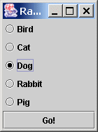
Example Summary
ButtonGroup ensures that only one radio button in the group can be selected at a time.
setSelected sets initial state. (Good for defaults).
isSelected checks the state of the button.

Slide 34
JComboBox
A combo box is a button that when pressed, presents a list of items that can be selected.

Slide 35
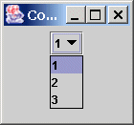
JComboBox Example
public class ComboBoxExample implements ActionListener {
JComboBox box;
public ComboBoxExample() {
JFrame frame = new JFrame("ComboBoxExample");
JPanel panel = new JPanel();
Set s = new TreeSet();
s.add(new Integer(1));
s.add(new Integer(2));
s.add(new Integer(3));
box = new JComboBox(s.toArray());
box.addActionListener(this);
panel.add(box);
frame.getContentPane().add(panel);
frame.pack();
frame.setVisible(true);
}
public static void main(String[] args) {
new ComboBoxExample();
}
public void actionPerformed(ActionEvent e) {
if ("comboBoxChanged".equals(e.getActionCommand())) {
System.out.println("User chose index " + box.getSelectedIndex());
} } }
notice use of collection

Slide 36
Example Summary
Notice the use of the Set.
If we were to get the combo box choices from a file, we could prohibit duplicates by using a Set.

Slide 37
Dialogs - JOptionPane
Dialogs are windows that are more limited than frames.
Every dialog is dependent on a frame. When that frame is destroyed, so are its dependent dialogs. When the frame is iconified, its dependent dialogs disappear from the screen. When the frame is deiconified, its dependent dialogs return to the screen.
To create simple dialogs, use the JOptionPane class.
The dialogs that JOptionPane provides are modal.
When a modal dialog is visible, it blocks user input to all other windows in the program.

Slide 38
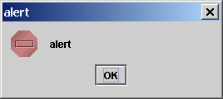
JOptionPane Examples
// show an error dialog
JOptionPane.showMessageDialog(null, "alert", "alert",
JOptionPane.ERROR_MESSAGE);

Slide 39
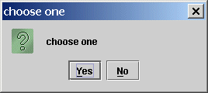
JOptionPane Examples
// show Yes/No dialog
int x = JOptionPane.showConfirmDialog(null,
"choose one", "choose one", JOptionPane.YES_NO_OPTION);
System.out.println("User clicked button " + x);

Slide 40
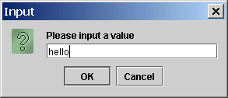
JOptionPane Examples
// show input dialog
String inputValue = JOptionPane.showInputDialog("Please input “ +
“a value");
System.out.println("User entered " + inputValue);

Slide 41
Layout Management
Layout managers control the size and arrangement of components in a container.
There are 6 common layout managers:
  BorderLayout
  BoxLayout
  FlowLayout
  GridBagLayout
  GridLayout
  CardLayout

Slide 42
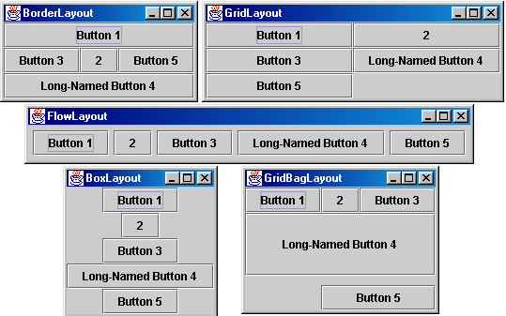
Layout Management

Slide 43
FlowLayout
Components are placed in a row from left to right in the order in which they are added.
A new row is started when no more components can fit in the current row.
The components are centered in each row by default.
The programmer can specify the size of both the vertical and horizontal gaps between the components.
FlowLayout is the default layout for JPanels.

Slide 44
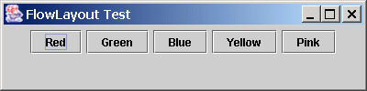
FlowLayout
Example
public class FlowLayoutTest extends JFrame {
JButton b1=new JButton("Red"),
b2=new JButton("Green"),b3=new JButton("Blue"),
b4=new JButton("Yellow"),b5=newJButton("Pink");
public FlowLayoutTest() {
setTitle("FlowLayout Test");
Container pane = getContentPane();
pane.setLayout(new FlowLayout());
setBounds(0,0,400,100);
pane.add(b1); pane.add(b2); pane.add(b3);
pane.add(b4); pane.add(b5);
}
public static void main(String args[]) {
JFrame f = new FlowLayoutTest();
f.setVisible(true);
}
}

Slide 45
BorderLayout
Defines five locations where a component or components can be added:
  North, South, East, West, and Center
The programmer specifies the area in which a component should appear.
The relative dimensions of the areas are governed by the size of the components added to them.

Slide 46
BorderLayout
North
West
Center
East
South

Slide 47
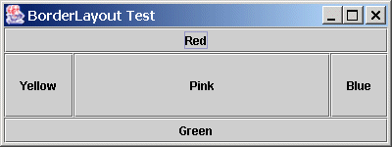
Border-Layout
Example
public class BorderLayoutTest extends JFrame {
JButton b1=new JButton("Red"),
b2=new JButton("Green"),b3=new JButton("Blue"),
b4=new JButton("Yellow"),b5=new JButton("Pink");
public BorderLayoutTest() {
setTitle("BorderLayout Test");
Container pane = getContentPane();
pane.setLayout(new BorderLayout());
setBounds(0,0,400,150);
pane.add(b1,"North"); pane.add(b2,"South"); pane.add(b3,"East");
pane.add(b4,"West"); pane.add(b5,"Center");
}
public static void main(String args[]) {
JFrame f = new BorderLayoutTest();
f.setVisible(true);
}
}
note extra parameter

Slide 48
GridLayout
Components are placed in a grid with a user-specified number of columns and rows.
Each component occupies exactly one grid cell.
Grid cells are filled left to right and top to bottom.
All cells in the grid are the same size.
Specifying zero for either rows or columns means any number of items can be placed in that row or column.

Slide 49
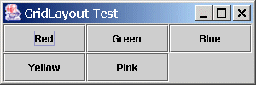
GridLayout
Example
public class GridLayoutTest extends JFrame {
JButton b1=new JButton("Red"),
b2=new JButton("Green"),b3=new JButton("Blue"),
b4=new JButton("Yellow"),b5=new JButton("Pink");
public GridLayoutTest() {
setTitle("GridLayout Test");
Container pane = getContentPane();
pane.setLayout(new GridLayout(2,3));
setBounds(0,0,300,100);
pane.add(b1); pane.add(b2); pane.add(b3);
pane.add(b4); pane.add(b5);
}
public static void main(String args[]) {
JFrame f = new GridLayoutTest();
f.setVisible(true);
}
}

Slide 50
CardLayout
Components governed by a card layout are "stacked" such that only one component is displayed on the screen at any one time.
Components are ordered according to the order in which they were added to the container.
Methods control which component is currently visible in the container.
CardLayouts might be appropriate for wizards (with the Next >> buttons).

Slide 51
CardLayout Example (1 of 3)
public class CardLayoutTest extends JFrame
implements ActionListener {
JButton b1 = new JButton("Red"),b2 = new JButton("Green"),
b3 = new JButton("Blue"),b4 = new JButton("Yellow"),
b5 = new JButton("Pink");
CardLayout lo = new CardLayout();
Container pane;
public CardLayoutTest() {
setTitle("CardLayout Test");
pane = getContentPane();
pane.setLayout(lo);
setBounds(0,0,200,100);
pane.add(b1,"1"); pane.add(b2,"2"); pane.add(b3,"3"); pane.add(b4,"4"); pane.add(b5,"5");
b1.addActionListener(this); b2.addActionListener(this);
b3.addActionListener(this); b4.addActionListener(this);
b5.addActionListener(this);
}

Slide 52
CardLayout Example (2 of 3)
// in the same file...
public void actionPerformed(ActionEvent e) {
if (e.getSource() == b1) lo.next(pane);
else if (e.getSource() == b2) lo.next(pane);
else if (e.getSource() == b3) lo.next(pane);
else if (e.getSource() == b4) lo.next(pane);
else if (e.getSource() == b5) lo.next(pane);
}
public static void main(String args[]) {
JFrame f = new CardLayoutTest();
f.setVisible(true);
}
}
define the behavior when the user clicks a button: in this case, we advance to the next card

Slide 53
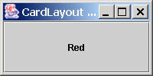
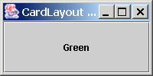



CardLayout Example (3 of 3)
Every arrow denotes a button click event. Our code reacts to the click by advancing to the next card. Note that the cards cycle.

Slide 54
Other Swing Components
You can see all the other Swing components at http://java.sun.com/products/jfc/tsc/articles/component_gallery/index.html

